Slide 1
A Look into Electric Vehicles
By:
Erin Babamoto
Jacob Girgle
John Gore
Silvart Mk
Rasheed Omolabi
Notes:
Jacob

Slide 2
Objective
The push for a more sustainable way of living through technology has been the forefront for many industries in the 21st century, specifically the vehicle industry.
Notes:
Silva:
If you are looking for a new vehicle that uses fuel in a cost-efficient way or want to reduce your green house gas emissions, you might be looking at an electric car for your next new car purchase.
Global EV sales rose a dramatic 65% from 2017 to 2018, for a total of 2.1 million vehicles in the US, with sale figures steady through 2019. ... The study finds that EVs hit 10% of global passenger vehicle sales by 2025, rising to 28% in 2030 and 58% in 2040. (SMK)

Slide 3
Objective
The push for a more sustainable way of living through technology has been the forefront for many industries in the 21st century, specifically the vehicle industry.
As more electric vehicles are introduced into the market the question remains, is this effort making impactful effects on the air quality?
Notes:
Silva:
According to the EPA, motor vehicles collectively cause 75 percent of carbon monoxide pollution in the U.S. The Environmental Defense Fund (EDF) estimates that on-road vehicles cause one-third of the air pollution that produces smog in the U.S., and transportation causes 27 percent of greenhouse gas emissions. (SMK)

Slide 4
Objective
The push for a more sustainable way of living through technology has been the forefront for many industries in the 21st century, specifically the vehicle industry.
As more electric vehicles are introduced into the market the question remains, is this effort making impactful effects on the air quality?
Our goal today is to try and bridge the gap on this question.
Notes:
Silva:
According to the EPA, motor vehicles collectively cause 75 percent of carbon monoxide pollution in the U.S. The Environmental Defense Fund (EDF) estimates that on-road vehicles cause one-third of the air pollution that produces smog in the U.S., and transportation causes 27 percent of greenhouse gas emissions. (SMK)

Slide 5
Research
Examination
Location: California
TimeFrame: 2009 - 2018
Notes:
Erin :
Besides the fact that most of us live in California, we chose to use it as the location for our research because California is the state with the highest population of electric vehicles
As of December 31, 2018, it accounted for approximately 47% of the overall population for vehicle registration counts of all-electric vehicles
We decided to focus on a 10 year period and 2009-2018 was the best time frame for the datasets we found

Slide 6
Research
Examination
Location: California
TimeFrame: 2009 - 2018
Electric Vehicle Data
California Department of Motor Vehicle car registration in Oct. 2018
Notes:
Erin:
Initially we were considering using Tesla sales as a dataset, but decided to expand our scope to include all electric vehicles to get a more holistic view of the effect of EV’s
The data we used was the California DMV’s vehicle registration count by fuel type as of October 31, 2018

Slide 7
Research
Examination
Location: California
TimeFrame: 2009 - 2018
Electric Vehicle Data
California Department of Motor Vehicle car registration in Oct. 2018
CO Emissions Data
EPA Air Quality Data (AQS)
EPA Air Quality Data (AQS)
Notes:
Erin:
Emissions data was more difficult to find than we anticipated, but we were able to find the information we needed in the Environmental Protection Agency’s air quality system database
John will touch more on this later, but while carbon dioxide is the largest vehicle emissions output, CO2 is very difficult to measure considering what else contributes to the amount in the atmosphere
We found carbon monoxide to be a good proxy for emissions coming from automobiles and decided to use that for the purpose of our project

Slide 8
Research
Examination
Location: California
TimeFrame: 2009 - 2018
Electric Vehicle Data
California Department of Motor Vehicle car registration in Oct. 2018
CO Emissions Data
EPA Air Quality Data (AQS)
CH4 Emissions Data
EPA Air Quality Data (AQS)
Notes:
Erin:
The other dataset we measured was methane, also from the EPA’s AQS database
We wanted to measure more than just one emission and methane is the second highest greenhouse gas emission behind carbon dioxide

Slide 9
Research Questions
01
What has been the yearly increase of electric vehicles introduced into the California market from 2009 - 2018?
Notes:
Hola:

Slide 10
Research Questions
01
What has been the yearly increase of electric vehicles introduced into the California market from 2009 - 2018?
02
What are the yearly carbon monoxide emission levels for California from 2009 - 2018?
Notes:
Hola:

Slide 11
Research Questions
01
What has been the yearly increase of electric vehicles introduced into the California market from 2009 - 2018?
02
What are the yearly carbon monoxide emission levels for California from 2009 - 2018?
03
What are the yearly methane emission levels for California from 2009 - 2018?
Notes:
Hola:

Slide 12
Research Questions
04
Is there a correlation between the use of electric vehicles and carbon monoxide levels?
Notes:
Hola:

Slide 13
Research Questions
04
Is there a correlation between the use of electric vehicles and carbon monoxide levels?
05
Is there a correlation between the use of electric vehicles and methane levels?
Notes:
Hola:

Slide 14
Research Questions
04
Is there a correlation between the use of electric vehicles and carbon monoxide levels?
05
Is there a correlation between the use of electric vehicles and methane levels?
06
By examining electric vehicles and the two chosen emissions, has the introduction of electric vehicles into the california market made an improvement on the air quality?
Notes:
Hola:

Slide 15
Vehicles in California
Electric Vehicles
1
2
Diesel and Diesel Hybrid
Flex-Fuel
3
4
Gasoline
Hybrid Gasoline
5
6
Hydrogen fuel cell
Natural Gas
7
8
Plug-in Hybrid
Notes:
John

Slide 16
Vehicles in California
Electric Vehicles
1
2
Diesel and Diesel Hybrid
Flex-Fuel
3
4
Gasoline
Hybrid Gasoline
5
6
Hydrogen fuel cell
Natural Gas
7
8
Plug-in Hybrid
Notes:
John

Slide 17
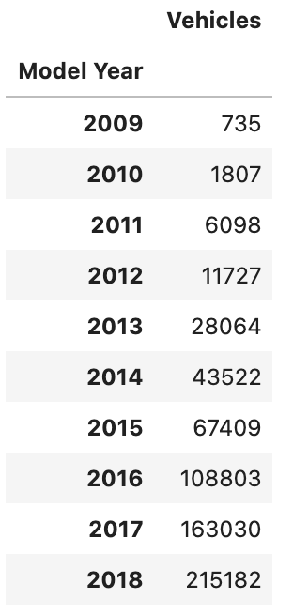
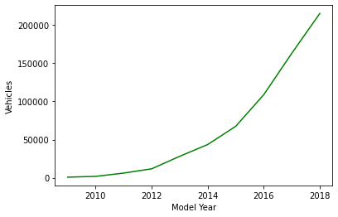
Electric Vehicles (2009 - 2018)
Notes:
Jacob

Slide 18
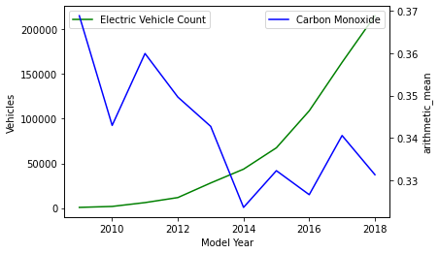
Electric Vehicles against Carbon Monoxide (2009 - 2018)
Notes:
Jacob

Slide 19
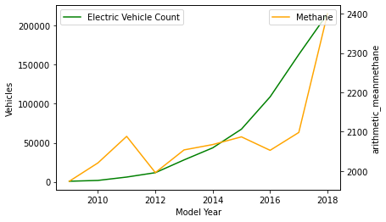
Electric Vehicles against Methane (2009 - 2018)
Notes:
JACOB

Slide 20
Electric Vehicle Correlations
Electric Vehicle vs Carbon Monoxide
-0.55
Notes:
Jacob

Slide 21
Electric Vehicle Correlations
Electric Vehicle vs Carbon Monoxide
-0.55
Electric Vehicle vs Methane
0.81
Notes:
Jacob

Slide 22
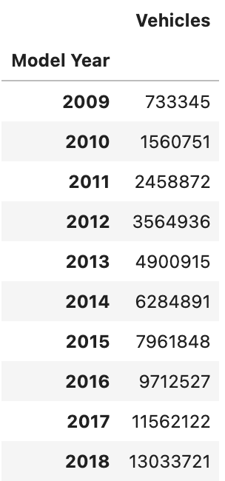
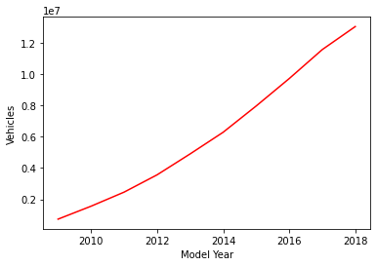
Gasoline Vehicles (2009 - 2018)

Slide 23
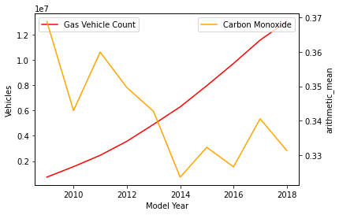
Gasoline Vehicles against Carbon Monoxide (2009 - 2018)

Slide 24
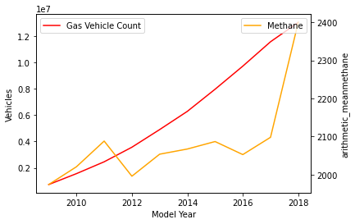
Gasoline Vehicles against Methane (2009 - 2018)

Slide 25
Gasoline Vehicle Correlations
Gas vs. Carbon Monoxide
-0.70

Slide 26
Gasoline Vehicle Correlations
Gas vs. Carbon Monoxide
-0.70
Gas vs. Methane
0.72

Slide 27
Vehicles in California
Gasoline Vehicles
82%

Slide 28
Vehicles in California
Gasoline Vehicles
Electric Vehicles
82%
1.4%

Slide 29
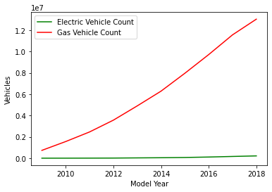
Vehicles in California
Gasoline Vehicles
Electric Vehicles
82%
1.4%

Slide 30
Limitations / Potential Areas for Future Study
01
04
Vehicle registration data may not capture prior year models that that are no longer being registered
Collect aggregate sales data and create a composite data set
02
05
CO2 represents 81% of vehicle emissions but CO2 difficult to measure from planet surface
Nasa JPL data as a possible solution
03
06
Questions over non-vehicle emission contributing factors to Methane levels
Cow farts and landfills to blame?
Notes:
03 :-CH4, while widely monitored, represents significantly smaller proportion of combustible engine emissions
-CH4 is primarily an agricultural emission so measurement could disproportionately impact measurements in farm areas
05: JG:Nasa JPL CO2 Virtual Science Data Environment offers rich data sets however their size and complexity make it impractical for the scope of this project
06: JG: CH4 at 10%, represents the second largest contributor to overall greenhouse gasses. Given its association with agricultural and waste landfills, accounting for higher concentrations in these areas in a future analysis might provide better insight. Aberrational events such as the Porter Ranch gas leak could

Slide 31

Questions?

